Slide 1


Home
About
Content
Others
Project on
Supply Chain Analysis
Next Slide | Supply Chain Analysis Presentation

Slide 2
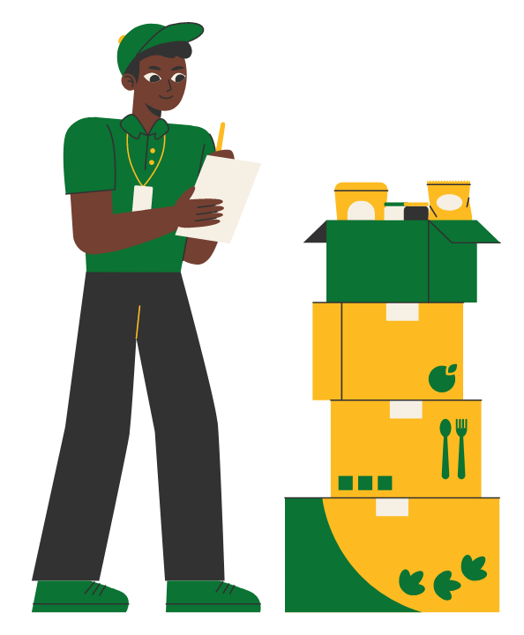
Home
About
Content
Others
This dataset comes from a Fashion and Beauty startup and reflects the complete supply chain operation of makeup products. It includes detailed information from suppliers to end customers- covering everything from manufacturing and stock management to shipping and customer data.
By analyzing this dataset, we can explore trends in product sales, detect supply chain bottlenecks, evaluate supplier performance, and optimize shipping strategies.
Dataset Source: kaggle.com

Slide 3
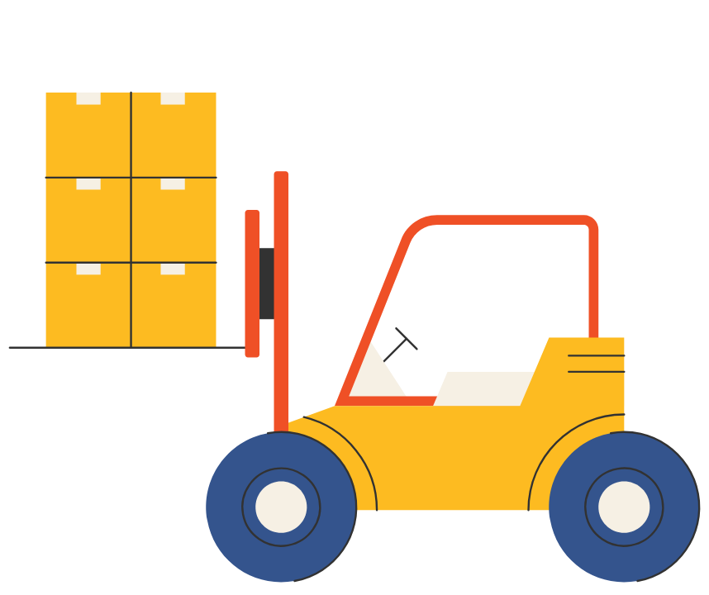
Home
About
Content
Others
Product Details- Product Type, SKU, Price, Availability
Sales Performance-
No. of Products Sold, Revenue Generated
Customer Demographics
Inventory Management- Stock Levels, Lead Times, Order Quantities
Shipping Data- Shipping Times, Shipping Carriers, Shipping Costs
Supplier & Location – Supplier Name, Location, Lead Time
Manufacturing Details – Production Volumes, Manufacturing Lead Time, Manufacturing Costs
Quality Checks- Inspection Results, Defect Rates
Logistics- Transportation Modes, Routes, Transportation Costs.

Slide 4
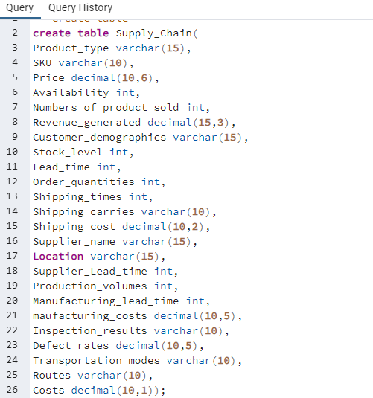
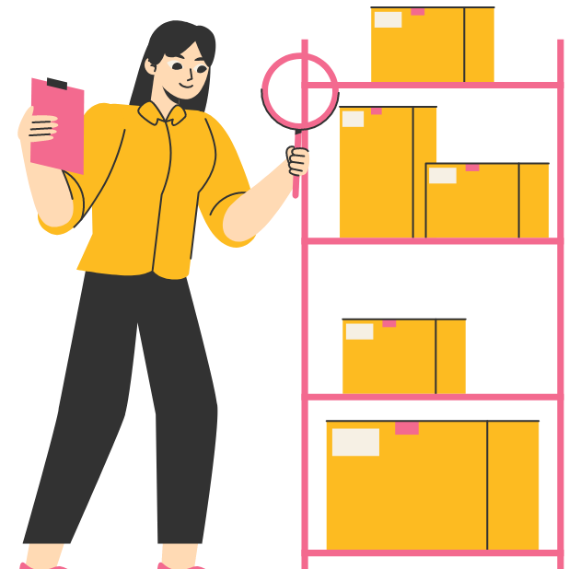
Home
About
Content
Others
Create table-

Slide 5
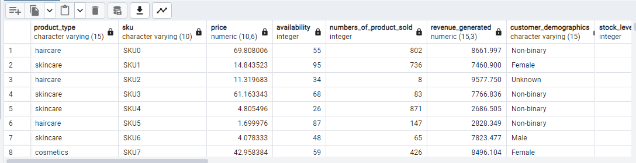
Home
About
Content
Others
Import data-

Slide 6


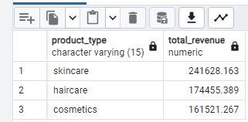
Home
About
Content
Others
1. Total revenue by product type-

Slide 7


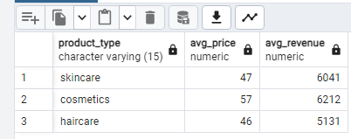
Home
About
Content
Others
2. Average price and revenue by product type-

Slide 8
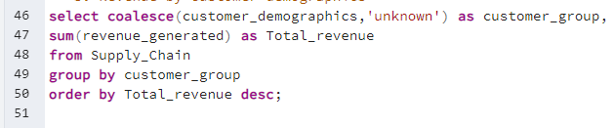

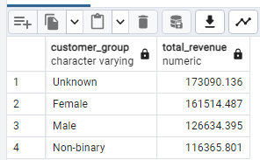
Home
About
Content
Others
3. Revenue by customer demographics-

Slide 9

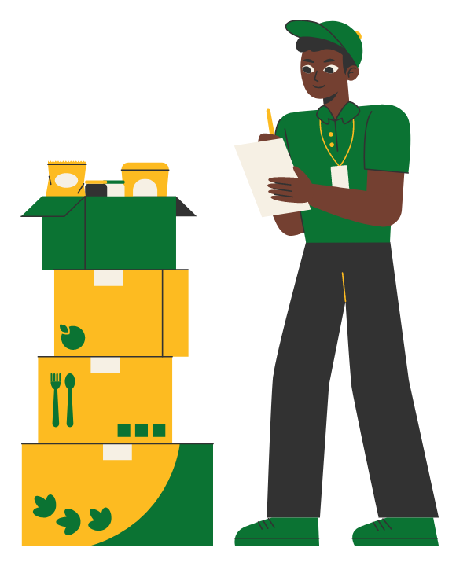
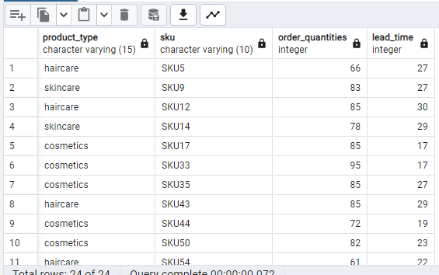
Home
About
Content
Others
4. large orders with long lead times-

Slide 10


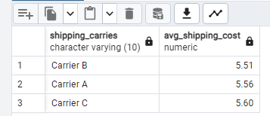
Home
About
Content
Others
5. Most cost-efficient shipping carrier-

Slide 11

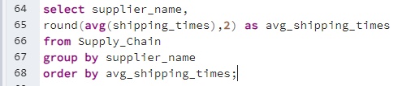
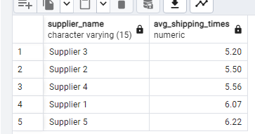
Home
About
Content
Others
6.Average shipping time by supplier-

Slide 12
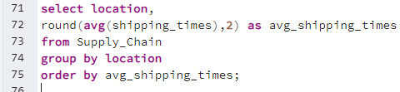

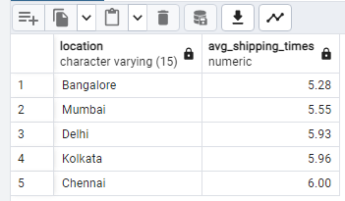
Home
About
Content
Others
7.City with fastest average shipping-

Slide 13
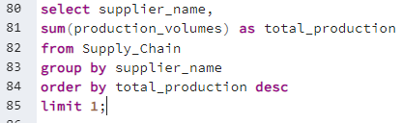

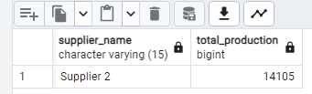
Home
About
Content
Others
8.Highest production volume supplier-

Slide 14

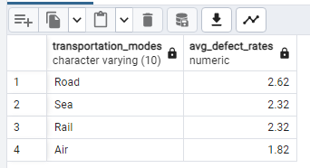
Home
About
Content
Others
9.Average defect rate by transport mode-

Slide 15
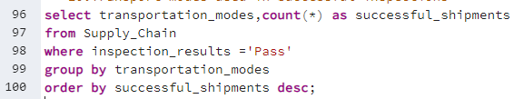
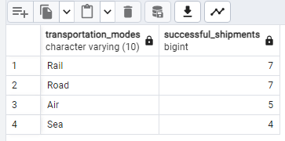
Home
About
Content
Others
10.Transport modes used in successful inspections-

Slide 16

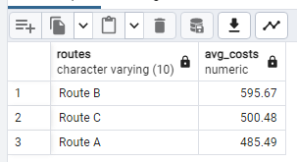
Home
About
Content
Others
11.Average transport cost by route-

Slide 17

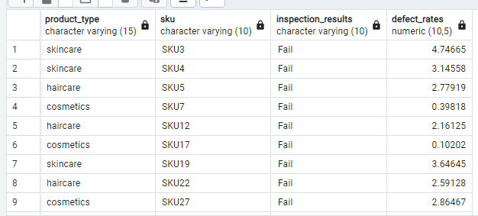
Home
About
Content
Others
12.Failied inspections with defect rates >3% -

Slide 18
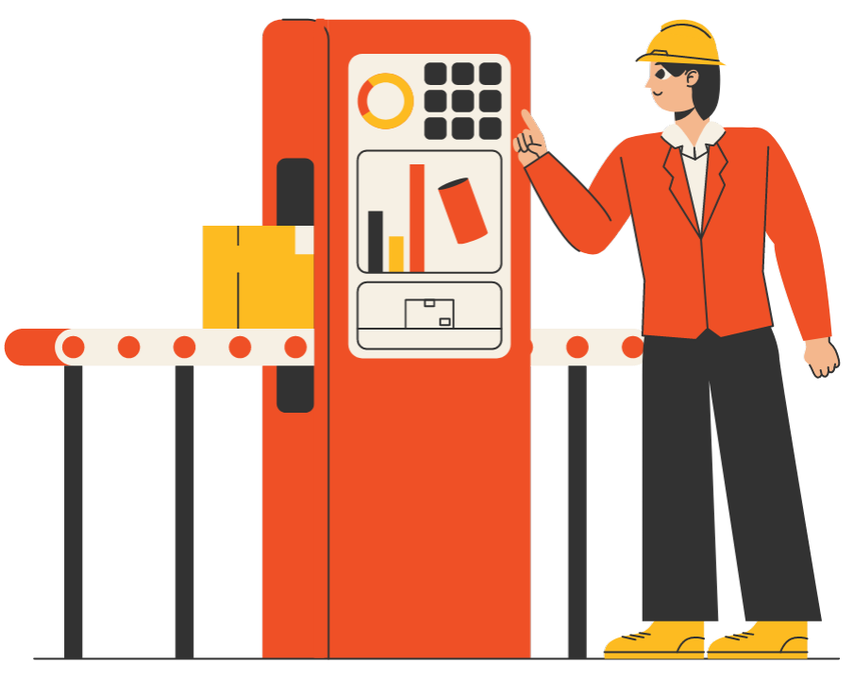
Home
About
Content
Others
Insights
Skincare generates the highest revenue (2,41,628) followed by hair care(1,74,455) and cosmetics (1,61,521).
Skincare is the main revenue driver for the business.
Cosmetics have the highest price(57) but don't make the most money because fewer are sold.
Skincare is cheaper(46) but sells a lot, so it earns more.
Hair care is the cheapest (40) and earns the least.
Unknown customers contribute the most revenue (1,73,090) followed by female(1,61,514) and male category (1,26,634).
Non-binary customers contribute the least(1,16,366).
Carrier B has the lowest average shipping cost(5.51), making it the most cost-effective option.
Carrier A and Carrier C have slightly higher costs( 5.56 and 5.60 respectively).
Supplier 3 delivers the fastest (5.20 days) and Supplier 5 has the slowest shipping time(6.22 days).
Bangalore has the fastest average shipping time (5.28 days), followed by Mumbai (5.55 days) and Delhi (5.93 days).
Chennai is the slowest ( 6 days).
Road transport has the most product defects (2.62).
Sea transport is second (2.32) and Air transport is the best( 1.82 defects only).
This means products are damaged more often in road and sea transport.

Slide 19
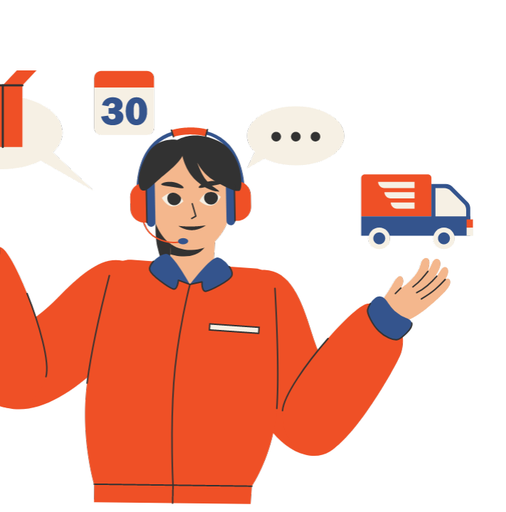

Home
About
Content
Others
Thank
You

